Slide 1
Solved Queries of ETL Project

Slide 2
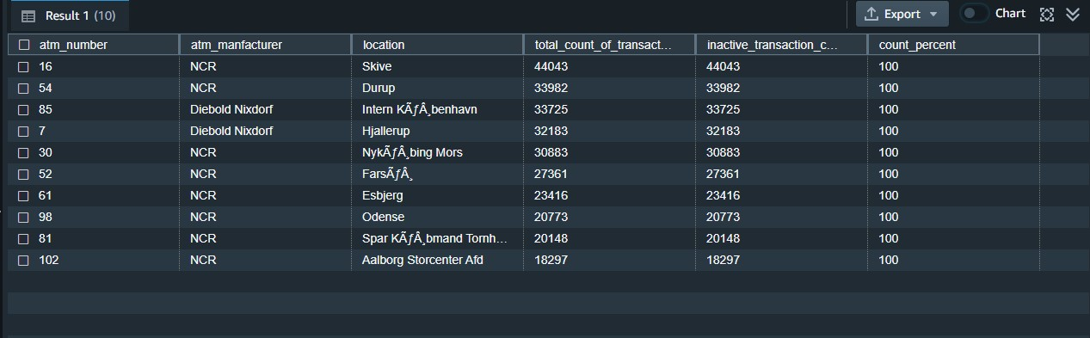
select
a.atm_number,
a.atm_manfacturer,
l.location,
count(trans_id) as total_count_of_transaction,
sum(case when atm_status = 'Inactive' then 1 else 0 end) as inactive_transaction_count,
(inactive_transaction_count/total_count_of_transaction)*100 as count_percent
from
atm_dump.atm_trans_detail atd,
atm_dump.atm_detail a,
atm_dump.atm_location l
where atd.atm_id = a.atmid
and a.atm_location_id = l.location_id
group by a.atm_number, a.atm_manfacturer, l.location
having count_percent > 50
order by inactive_transaction_count desc
limit 10;

Slide 3
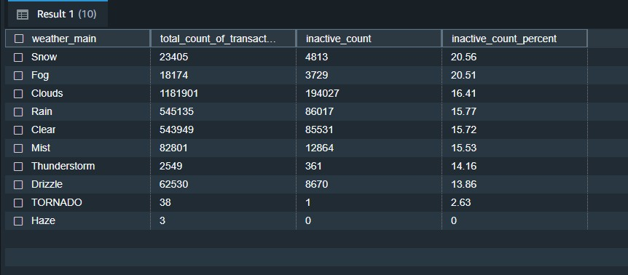
select
atd.weather_main,
count(trans_id) as total_count_of_transaction,
sum(case when atm_status = 'Inactive' then 1 else 0 end) as inactive_count,
case when coalesce(inactive_count, 0) = 0 then 0.0000 else trunc((cast(inactive_count as
numeric(10,4))/total_count_of_transaction)*100, 2) end as inactive_count_percent
from
atm_dump.atm_trans_detail atd
where atd.weather_main != ''
group by atd.weather_main
order by inactive_count_percent desc
limit 10;

Slide 4
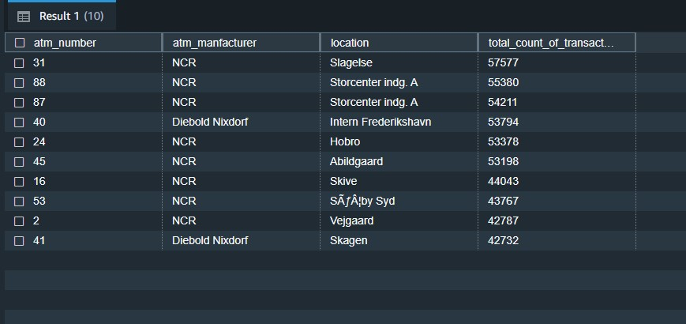
select
a.atm_number,
a.atm_manfacturer,
l.location,
count(trans_id) as total_count_of_transaction
from
atm_dump.atm_trans_detail atd,
atm_dump.atm_detail a,
atm_dump.atm_location l
where atd.atm_id = a.atmid
and a.atm_location_id = l.location_id
group by a.atm_number, a.atm_manfacturer, l.location
order by total_count_of_transaction desc
limit 10;

Slide 5
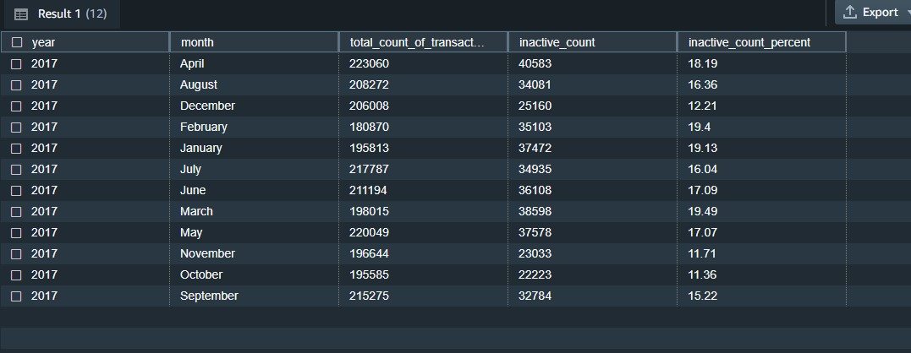
select
d.year,
d.month,
count(trans_id) as total_count_of_transaction,
sum(case when atm_status = 'Inactive' then 1 else 0 end) as inactive_count, case when
coalesce(inactive_count, 0) = 0 then 0.0000 else trunc((cast(inactive_count as
numeric(10,4))/total_count_of_transaction)*100, 2) end as inactive_count_percent
from
atm_dump.atm_trans_detail atd
inner join atm_dump.atm_date d on atd.date_id = d.date_id
group by d.year, d.month
order by d.year, d.month;

Slide 6
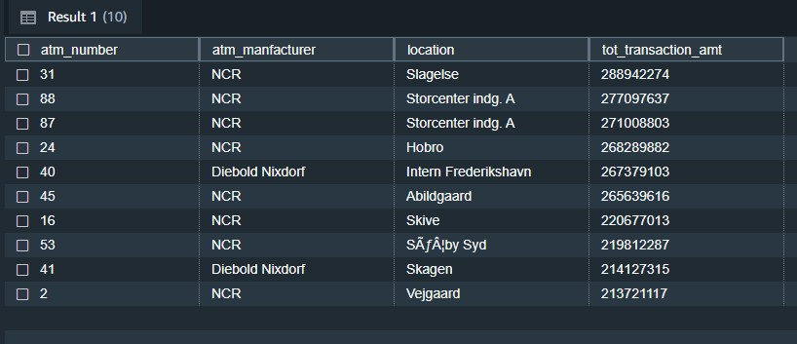
select
a.atm_number,
a.atm_manfacturer,
l.location,
sum(tansaction_amt) as tot_transaction_amt
from
atm_dump.atm_trans_detail atd,
atm_dump.atm_detail a,
atm_dump.atm_location l
where atd.atm_id = a.atmid
and a.atm_location_id = l.location_id
group by a.atm_number, a.atm_manfacturer, l.location
order by tot_transaction_amt desc
limit 10;

Slide 7
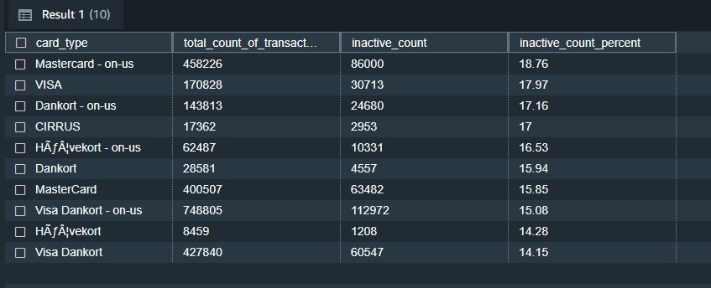
select
ct.card_type,
count(trans_id) as total_count_of_transaction,
sum(case when atm_status = 'Inactive' then 1 else 0 end) as inactive_count, case when
coalesce(inactive_count, 0) = 0 then 0.0000 else trunc((cast(inactive_count as
numeric(10,4))/total_count_of_transaction)*100, 2) end as inactive_count_percent
from
atm_dump.atm_trans_detail atd,
atm_dump.card_type ct
where atd.card_type_id = ct.card_type_id
group by ct.card_type
order by inactive_count_percent desc
limit 10;

Slide 8
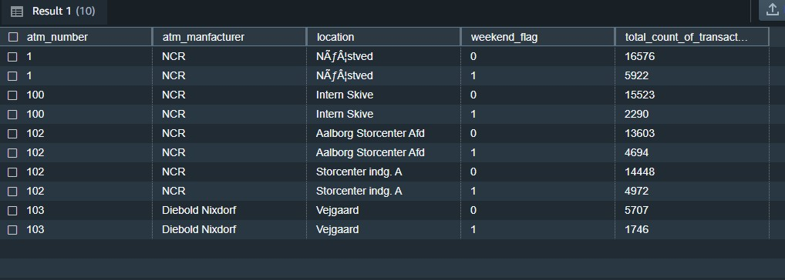
where
atd.atm_id = a.atmid
and a.atm_location_id = l.location_id
and atd.date_id = d.date_id
group by a.atm_number, a.atm_manfacturer, l.location, weekend_flag
order by a.atm_number, a.atm_manfacturer, l.location, weekend_flag, total_count_of_transaction
limit 10;
select
a.atm_number,
a.atm_manfacturer,
l.location, case when d.weekday in ('Saturday','Sunday') then 1 else 0 end as weekend_flag,
count(trans_id) as total_count_of_transaction
from
atm_dump.atm_trans_detail atd,
atm_dump.atm_detail a, atm_dump.atm_location l,
atm_dump.atm_date d

Slide 9
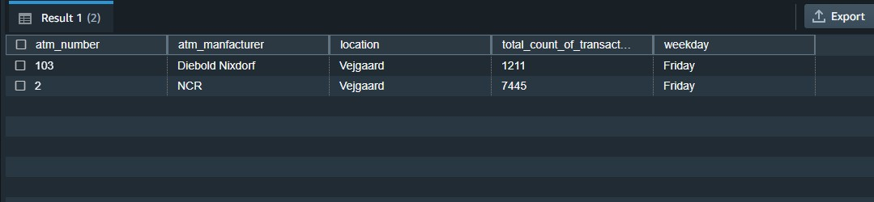
select
a.atm_number,
a.atm_manfacturer,
l.location,
d.weekday,
count(trans_id) as total_count_of_transaction
from
atm_dump.atm_trans_detail atd
inner join atm_dump.atm_detail a on atd.atm_id = a.atmid
inner join atm_dump.atm_location l on a.atm_location_id = l.location_id
inner join atm_dump.atm_date d on atd.date_id = d.date_id
where
l.location = 'Vejgaard'
and d.weekday
in ( select d.weekday from atm_dump.atm_trans_detail atd
inner join atm_dump.atm_date d on atd.date_id = d.date_id
inner join atm_dump.atm_location l on atd.weather_loc_id = l.location_id
where l.location = 'Vejgaard'
group by d.weekday
order by count(atd.trans_id) desc
limit 1 )
group by a.atm_number, a.atm_manfacturer, l.location, d.weekday
order by total_count_of_transaction

